Slide 1
SLEEP DISORDER PREDICTION
SUBMITTED BY
MEGHAVANI. S

Slide 2
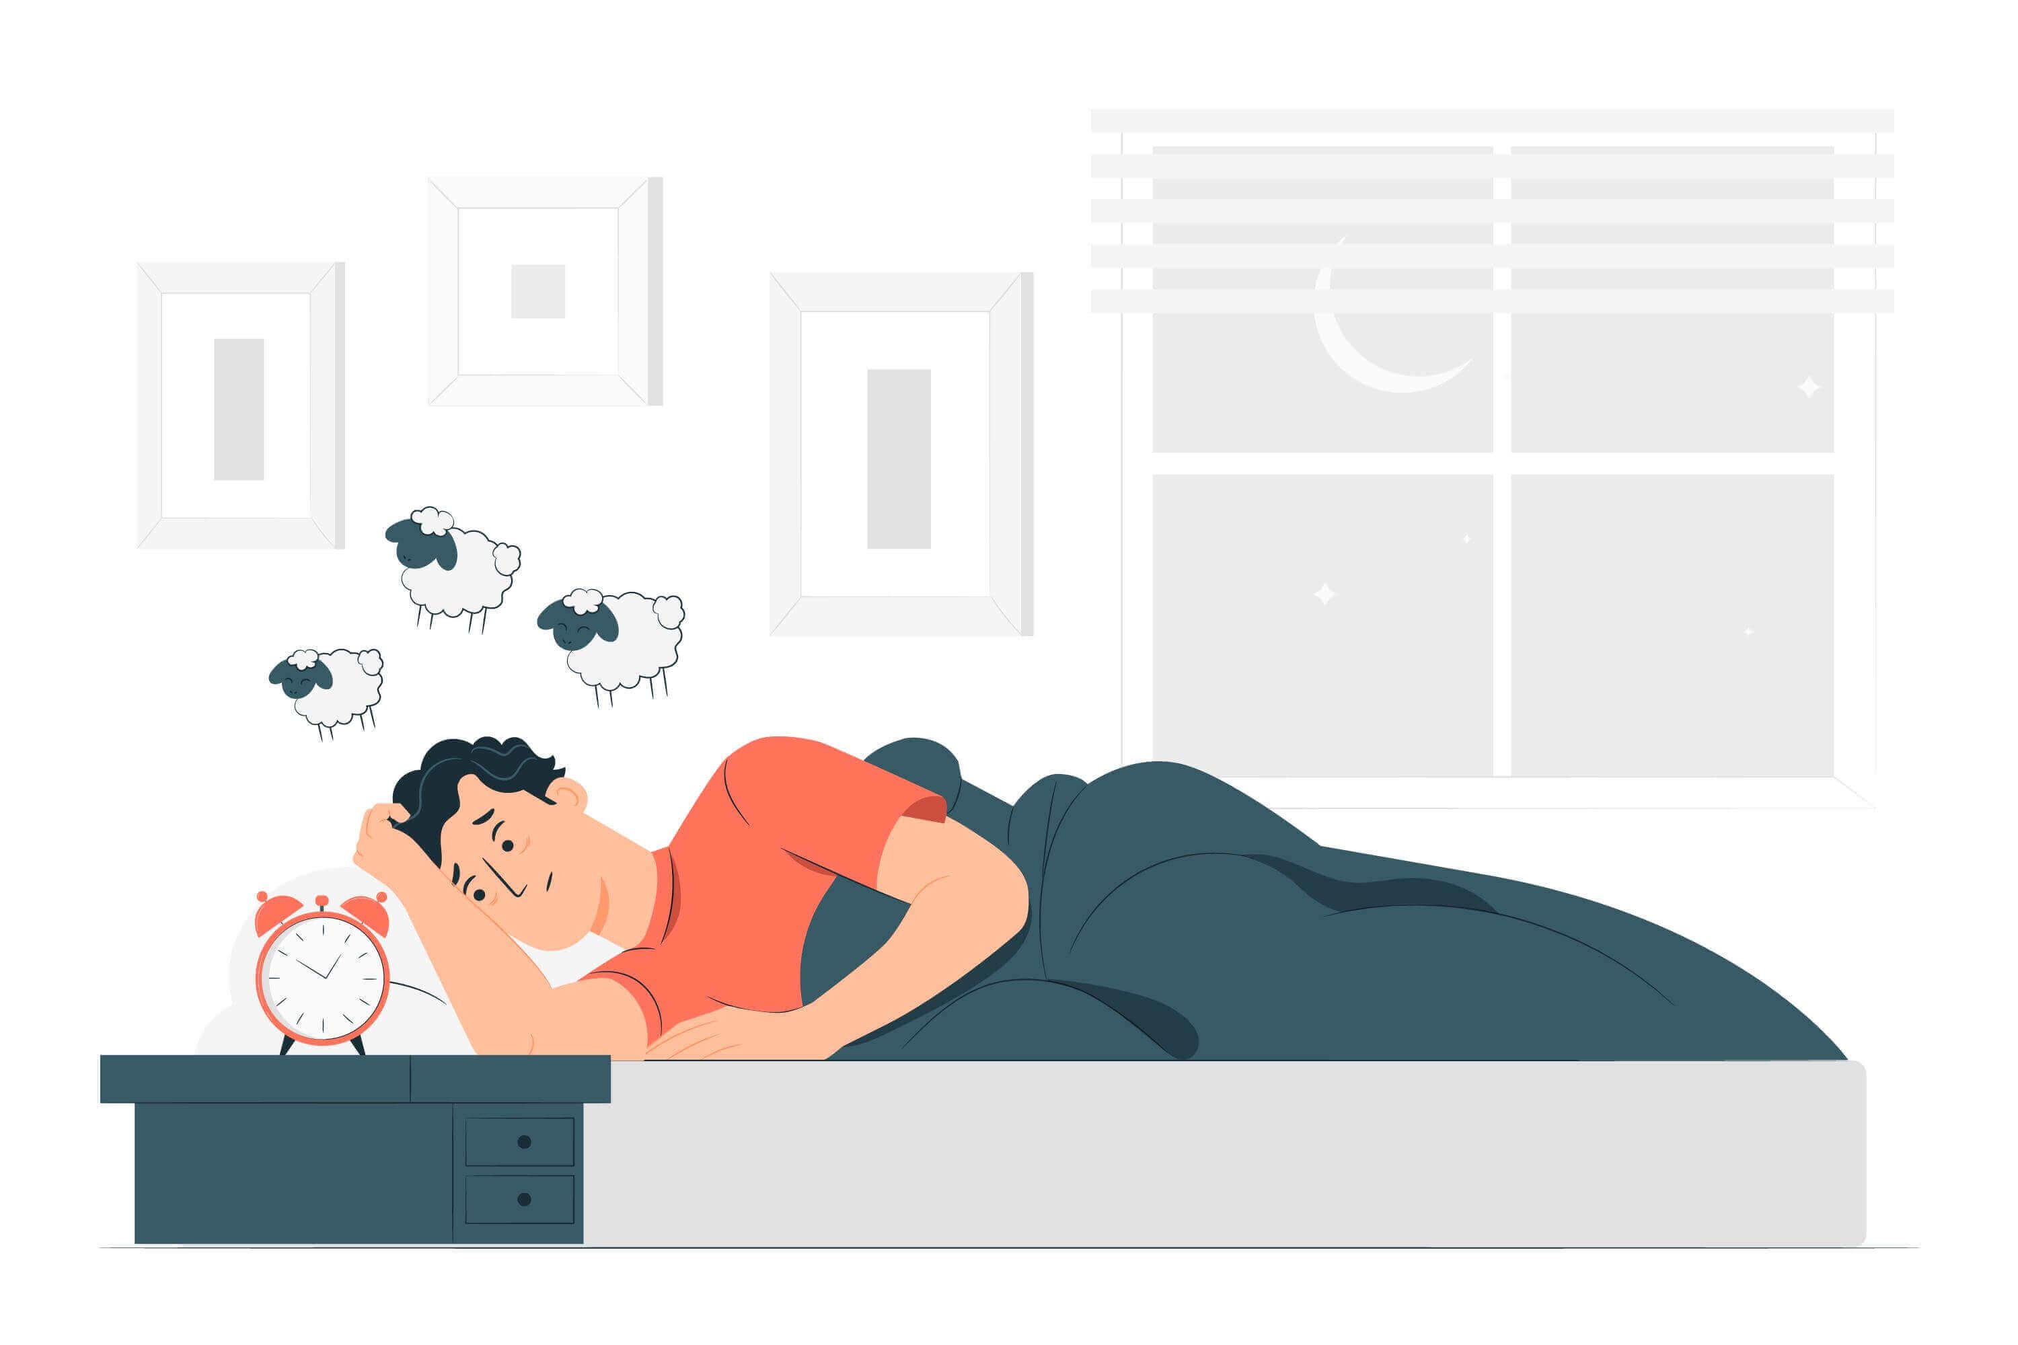
AGENDA
Introduction
Data Collection
EDA
Data Preprocessing
Model Selection
Conclusion

Slide 3
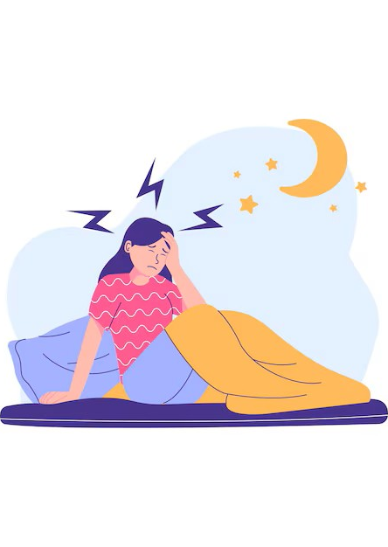
Introduction
Sleep disorders like Insomnia and Sleep Apnea are common yet underdiagnosed conditions that can severely affect an individual's quality of life, health, and productivity. Timely and accurate identification is crucial but often limited by clinical resources. This project focuses on building a machine learning solution to classify individuals into three categories: No Disorder, Insomnia, and Sleep Apnea, using lifestyle and health-related data.

Slide 4
Importance of Identifying Sleep Disorders
Early detection helps prevent chronic health issues like hypertension, diabetes, and depression.
Reduces economic burden on healthcare systems.
Enables personalized healthcare interventions.
Empowers patients to make lifestyle adjustments for better sleep hygiene.

Slide 5
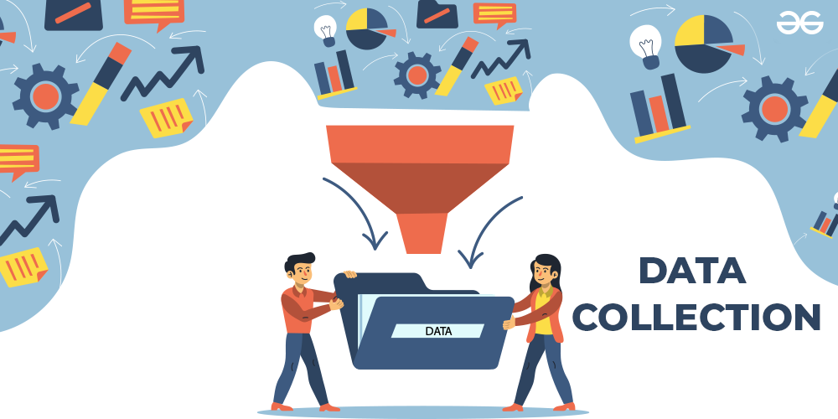

Slide 6
Understanding the Data
Number of Rows:
374
Number of Columns:
13
Numerical: 9 columns
Categorical: 4 columns

Slide 7
Features
Sl.No. | Feature Names | Description
1 | Person ID | Unique ID assigned to each person
2 | Gender | The gender of the person (Male/Female)
3 | Age | Age of the person
4 | Occupation | The occupation of the person
5 | Sleep Duration | The duration of sleep of the person in hours
6 | Quality of Sleep | A subjective rating of the quality of sleep, ranging from 1 to 10
7 | Physical Activity | The level of physical activity of the person (Low/Medium/High)
8 | Stress Level | A subjective rating of the stress level, ranging from 1 to 10
9 | BMI category | The BMI category of the person (Underweight/Normal/Overweight/Obesity)
10 | Blood Pressure | The blood pressure of the person in mmHg
11 | Heart Rate | The heart rate of the person in beats per minute
12 | Daily Steps | The number of steps taken by the person per day
13 | Sleep Disorder | The presence or absence of a sleep disorder in the person (None, Insomnia, Sleep Apnea

Slide 8
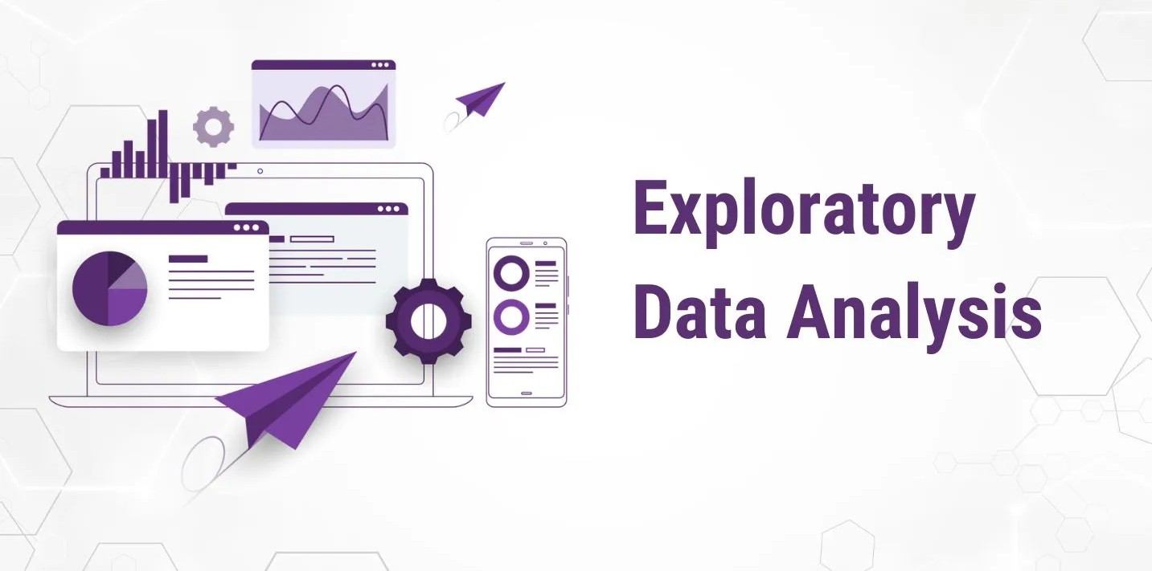

Slide 9
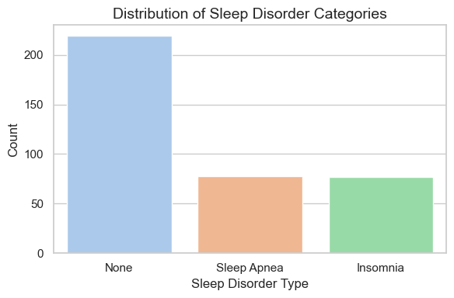
Distribution of Sleep Disorder Categories
The majority of individuals (over 200) in the dataset do not suffer from any sleep disorder.
Both Sleep Apnea and Insomnia affect a comparable number of individuals, each accounting for a smaller yet significant portion of the population.
This class imbalance highlights the importance of using appropriate modeling techniques to avoid bias toward the majority class.

Slide 10
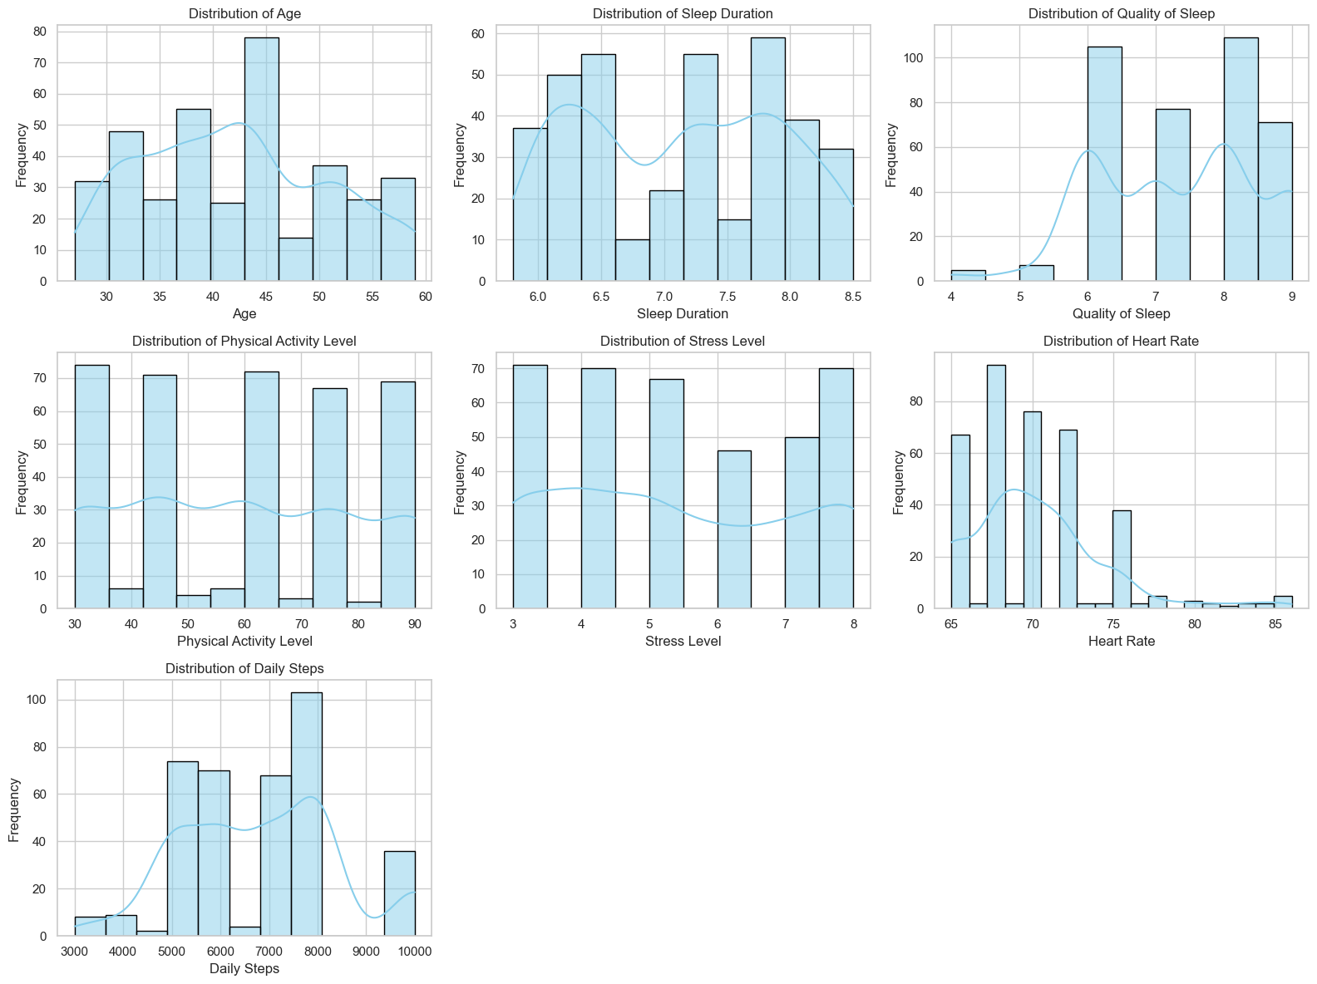
Univariate Analysis of Numerical Features:

Slide 11
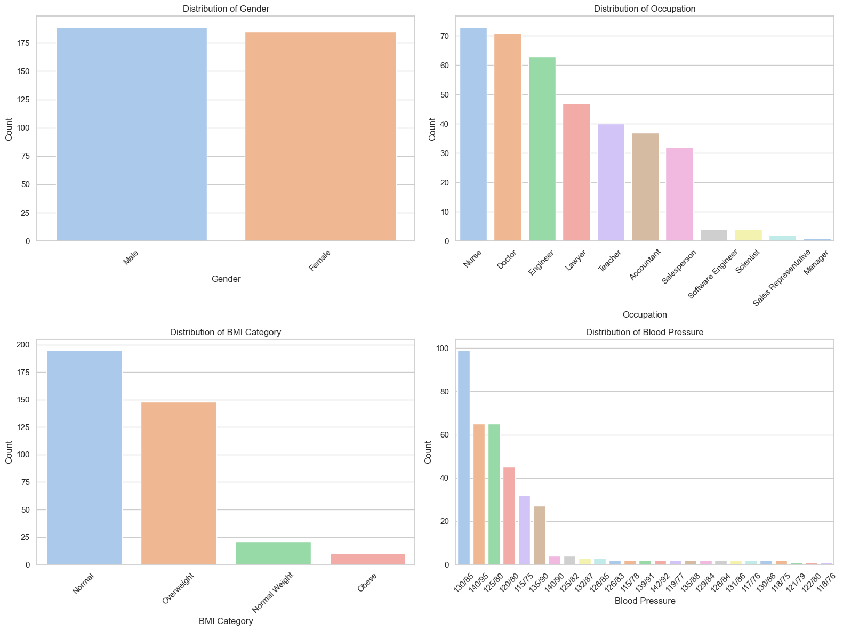
Univariate Analysis of Categorical Features:

Slide 12
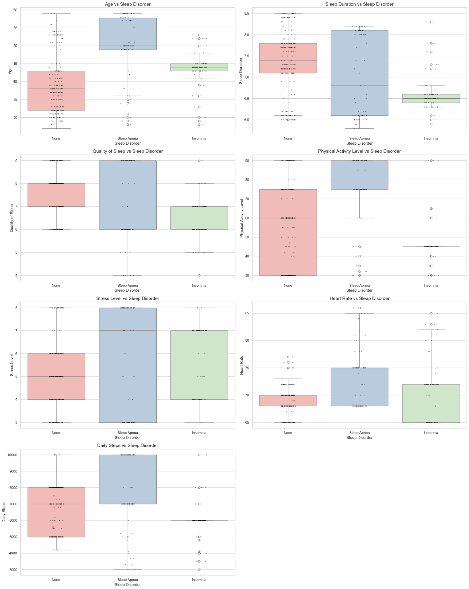
Bivariate Analysis: Numerical Features vs Sleep Disorders:

Slide 13
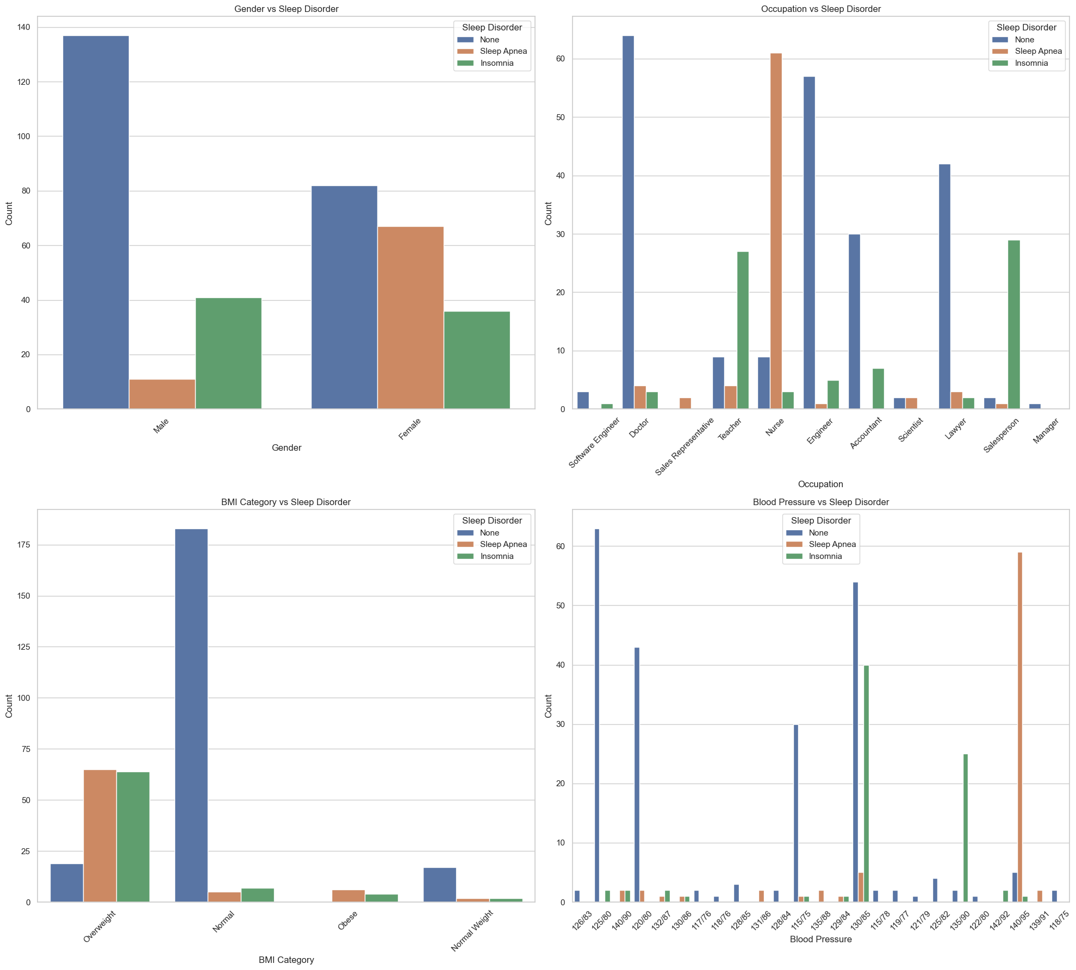
Bivariate Analysis: Categorical Features vs. Sleep Disorder:

Slide 14
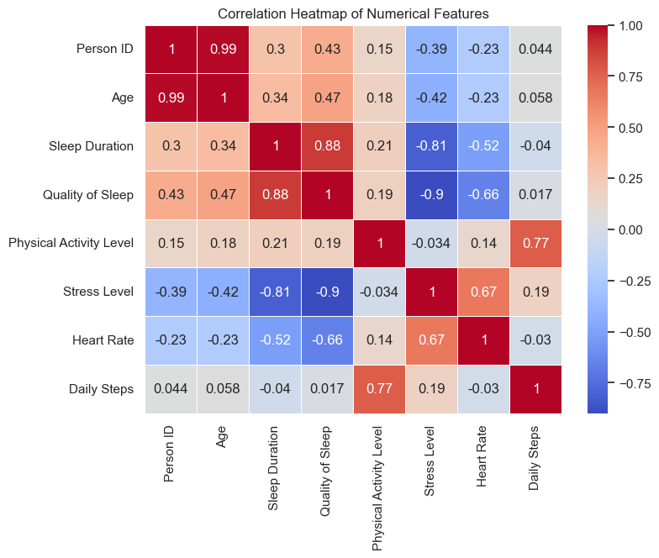
Correlation Heatmap :

Slide 15
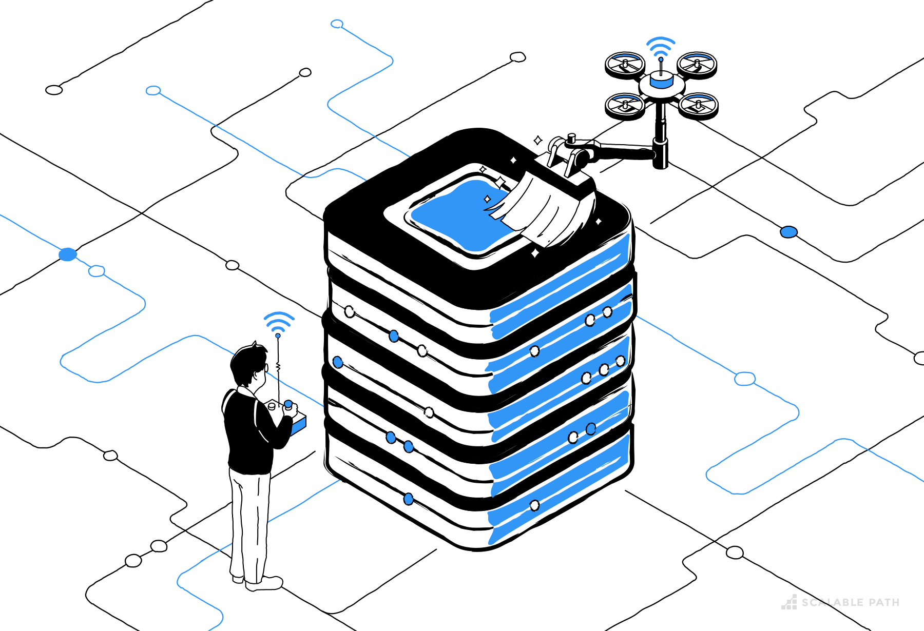
DATA PREPROCESSING AND FEATURE ENGINEERING

Slide 16
Data Preprocessing
Handling Missing Values : Missing values were identified and imputed to ensure dataset completeness and maintain model integrity. No missing and duplicate rows are found.
Feature Engineering : Splitting Blood Pressure into Systolic & Diastolic. Dropped the original 'Blood Pressure' column.This improves model interpretability and allows these new features to be included in numerical analysis.
Encoding Categorical Variables : Categorical features were converted into numerical format using Label Encoding and One-Hot Encoding to make the data suitable for machine learning models.
Feature Scaling : Numerical features were scaled using StandardScaler to bring them to a common range, helping distance-based models perform effectively.

Slide 17
Train-Test Split
The data was split into training and testing sets to assess model generalization on unseen data.
Training Set (80%): Used to train the model.
Testing Set (20%): Used to evaluate the model’s performance on unseen data.

Slide 18
MODEL SELECTION

Slide 19
Models Used
The dataset is trained with all mentioned models and the evaluation metrics are used to check the performance.
Decision Tree
Random Forest
Logistic Regression
XG Boost

Slide 20
Hyperparameter Tuning and Model
Tuning is the process of finding the best settings (hyperparameters) for a machine learning model to improve its performance.
We’ll use tools like GridSearchCV to:
Automatically test many combinations of hyperparameters.
Evaluate them using cross-validation.
Select the combination that performs best.

Slide 21
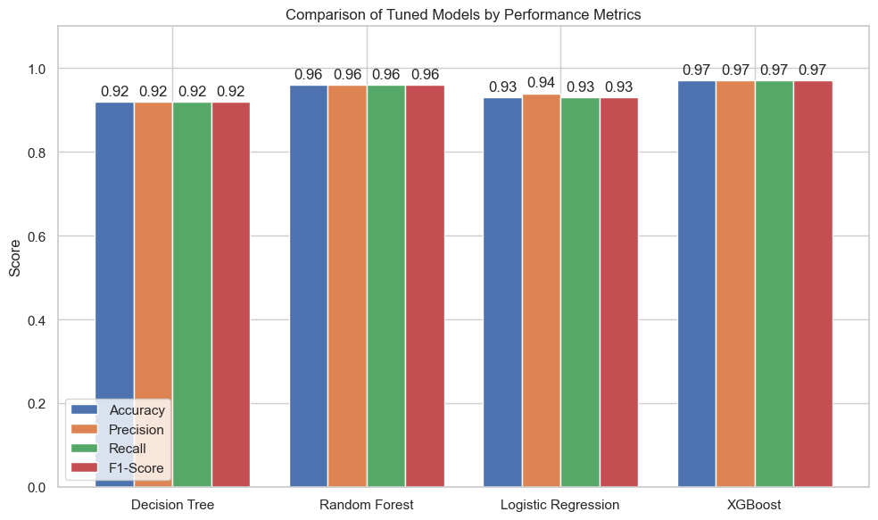
Model Evaluation
This bar chart compares the performance of four tuned models—Decision Tree, Random Forest, Logistic Regression, and XGBoost—using Accuracy, Precision, Recall, and F1-Score.
The Decision Tree model shows the lowest performance, with all metrics at 0.92, indicating consistent but relatively limited classification capability due to its simplicity.
Random Forest and Logistic Regression show better results. Random Forest scores 0.96 across all metrics, reflecting strong performance through ensemble learning. Logistic Regression achieves 0.93 in Accuracy, Recall, and F1-Score, and 0.94 in Precision, showing decent results but not ideal for capturing complex patterns.
XGBoost outperforms all others, scoring 0.97 in every metric. Its high accuracy, generalization, and consistent multiclass classification ability make it the most reliable. Therefore, XGBoost was chosen as the final model for its robustness and superior predictive power in detecting sleep disorders.

Slide 22
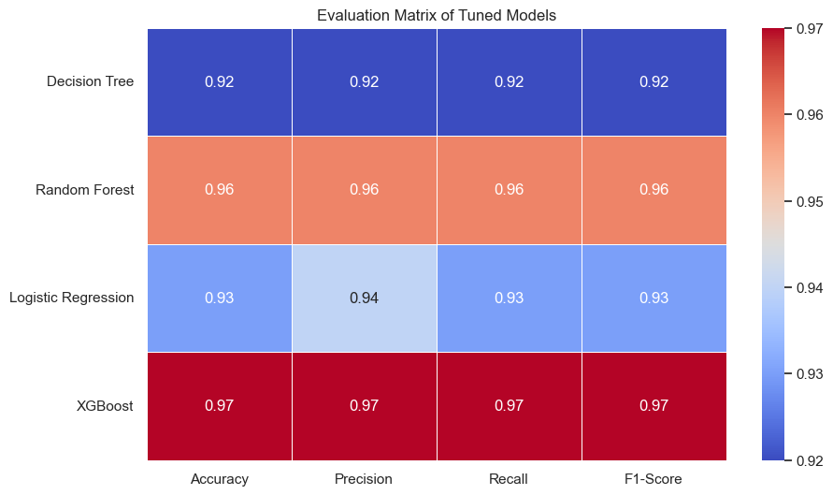
Model Evaluation Matrix:
🔴 XGBoost Performs Best Overall:
This indicates that the XGBoost model is the most balanced and reliable among the models tested for predicting sleep disorders.
🟠 Random Forest is a Strong Contender:
It can be a good alternative if XGBoost’s computational cost is a concern.
🔵 Logistic Regression Shows Moderate Performance:
It may still be useful due to its simplicity and interpretability.
🔵 Decision Tree Performs the Least:
It might be prone to overfitting and lacks the robustness of ensemble methods

Slide 23
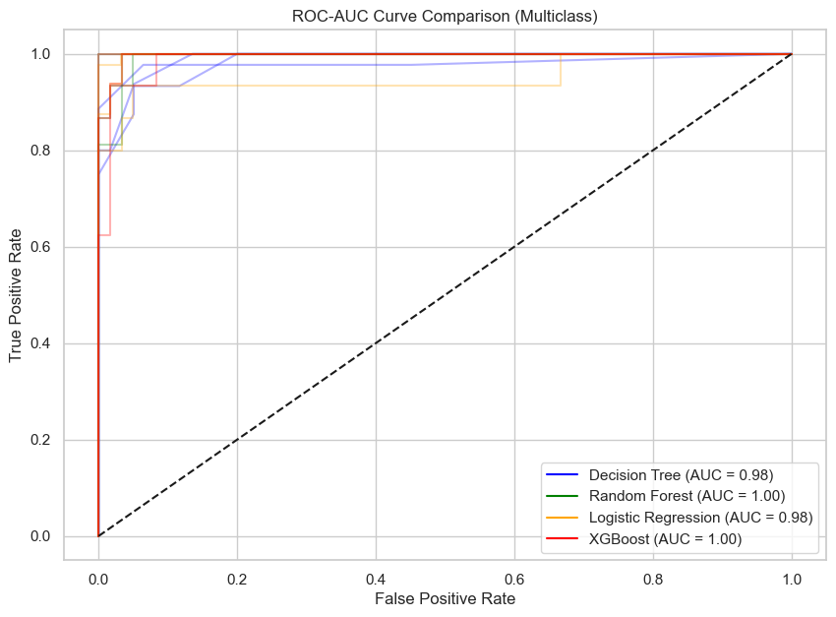
ROC-AUC CURVE
The Random Forest (green) and XGBoost (red) models show superior performance with AUC scores of 1.00, indicating perfect classification on the dataset.
The Decision Tree (blue) and Logistic Regression (yellow) models also perform well, with AUC scores of 0.98, but are slightly less effective than the other two models.

Slide 24
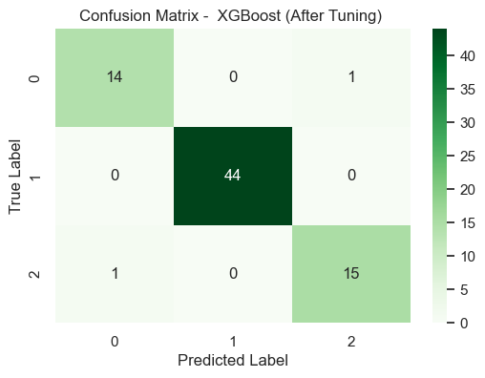
Confusion Matrix: XGBoost (Best Model)
Insomnia (Class 0) : 14 instances were correctly predicted as insomnia, while 1 instance was incorrectly predicted as sleep apnea.
None (Class 1) : All 44 instances were correctly predicted as none.
Sleep Apnea (Class 2) : 15 instances were correctly predicted as sleep apnea, while 1 instance was incorrectly predicted as insomnia.
The confusion matrix for the tuned XGBoost model shows nearly perfect classification with minimal misclassification errors across all classes, confirming its outstanding predictive power for sleep disorder detection.

Slide 25
CONCLUSION
This project aimed to predict sleep disorders—None, Insomnia, and Sleep Apnea—using patient lifestyle and medical data through a machine learning pipeline. We began with data preprocessing, including handling missing values, encoding categorical variables, and standardization. Exploratory Data Analysis (EDA) helped identify patterns and relationships within the data.
We then trained and tuned four classification models: Decision Tree, Random Forest, Logistic Regression, and XGBoost, evaluating each using accuracy, precision, recall, F1-score, and multiclass ROC-AUC. Visual tools like bar plots, heatmaps, and ROC curves were used to support comparison. XGBoost was selected as the final model, achieving the highest accuracy (97%) and strong scores across all evaluation metrics, with excellent ROC-AUC performance, making it the most reliable in distinguishing between disorder types.
This project demonstrates how machine learning can support early detection of sleep disorders, aiding clinical decisions and potentially improving patient outcomes through timely, data-driven insights.

Slide 26
Future Scope
Feature Expansion: Integrate additional biometric and lifestyle features such as heart rate variability, diet, etc.
Model Explainability: Use tools like SHAP or LIME for interpreting predictions to support clinical decision-making.
Deep Learning: Explore RNNs or CNNs if time-series sleep data (like EEG) is available.
Mobile Integration: Deploy the model in a user-friendly app to collect real-time inputs from wearable devices.
Cross-population Testing: Validate the model’s performance across diverse demographic and geographic groups to improve robustness.

Slide 27
Dashboard Using Power BI

Slide 28
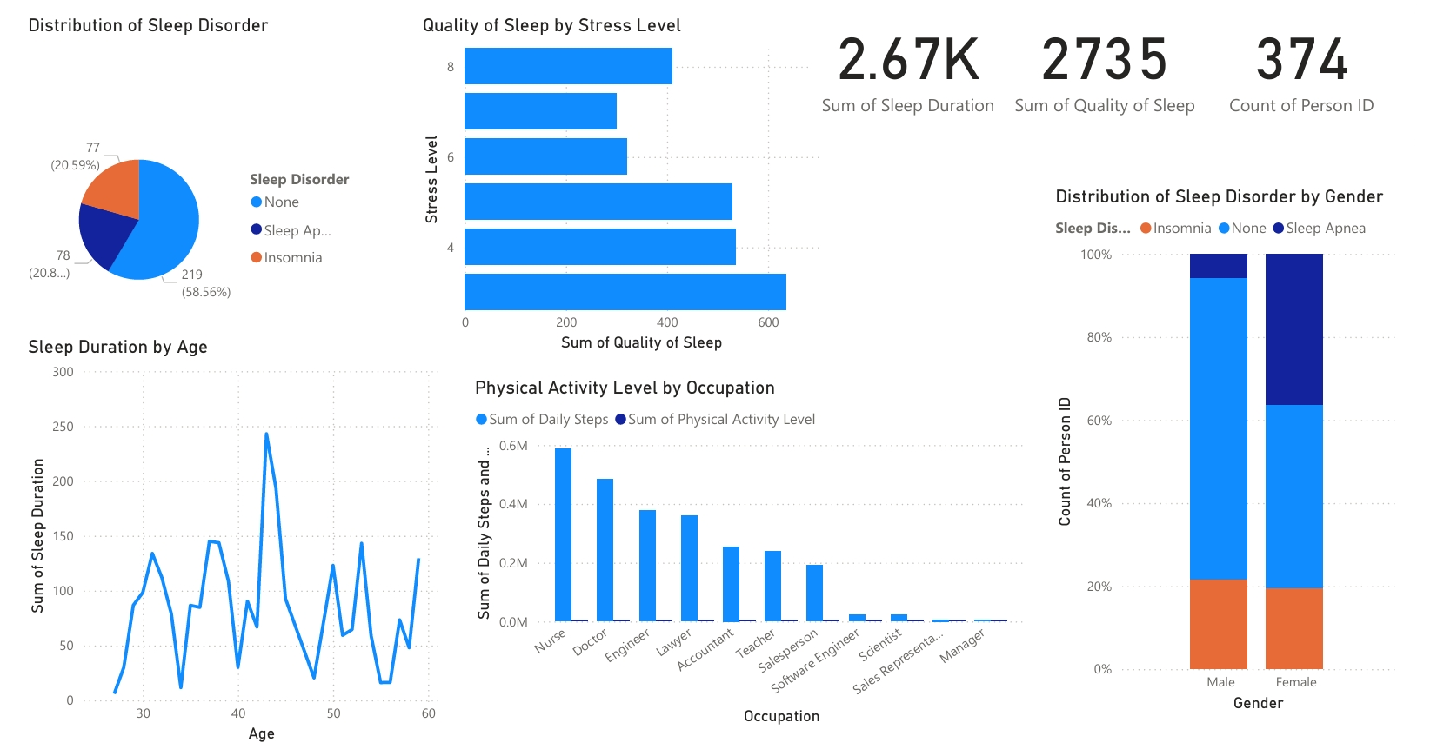

Slide 29
THANK YOU !

